Slide 1
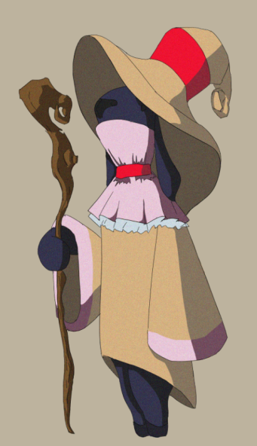
Concept Art
Project 7 - Accessibility

Slide 2
Characters

Slide 4
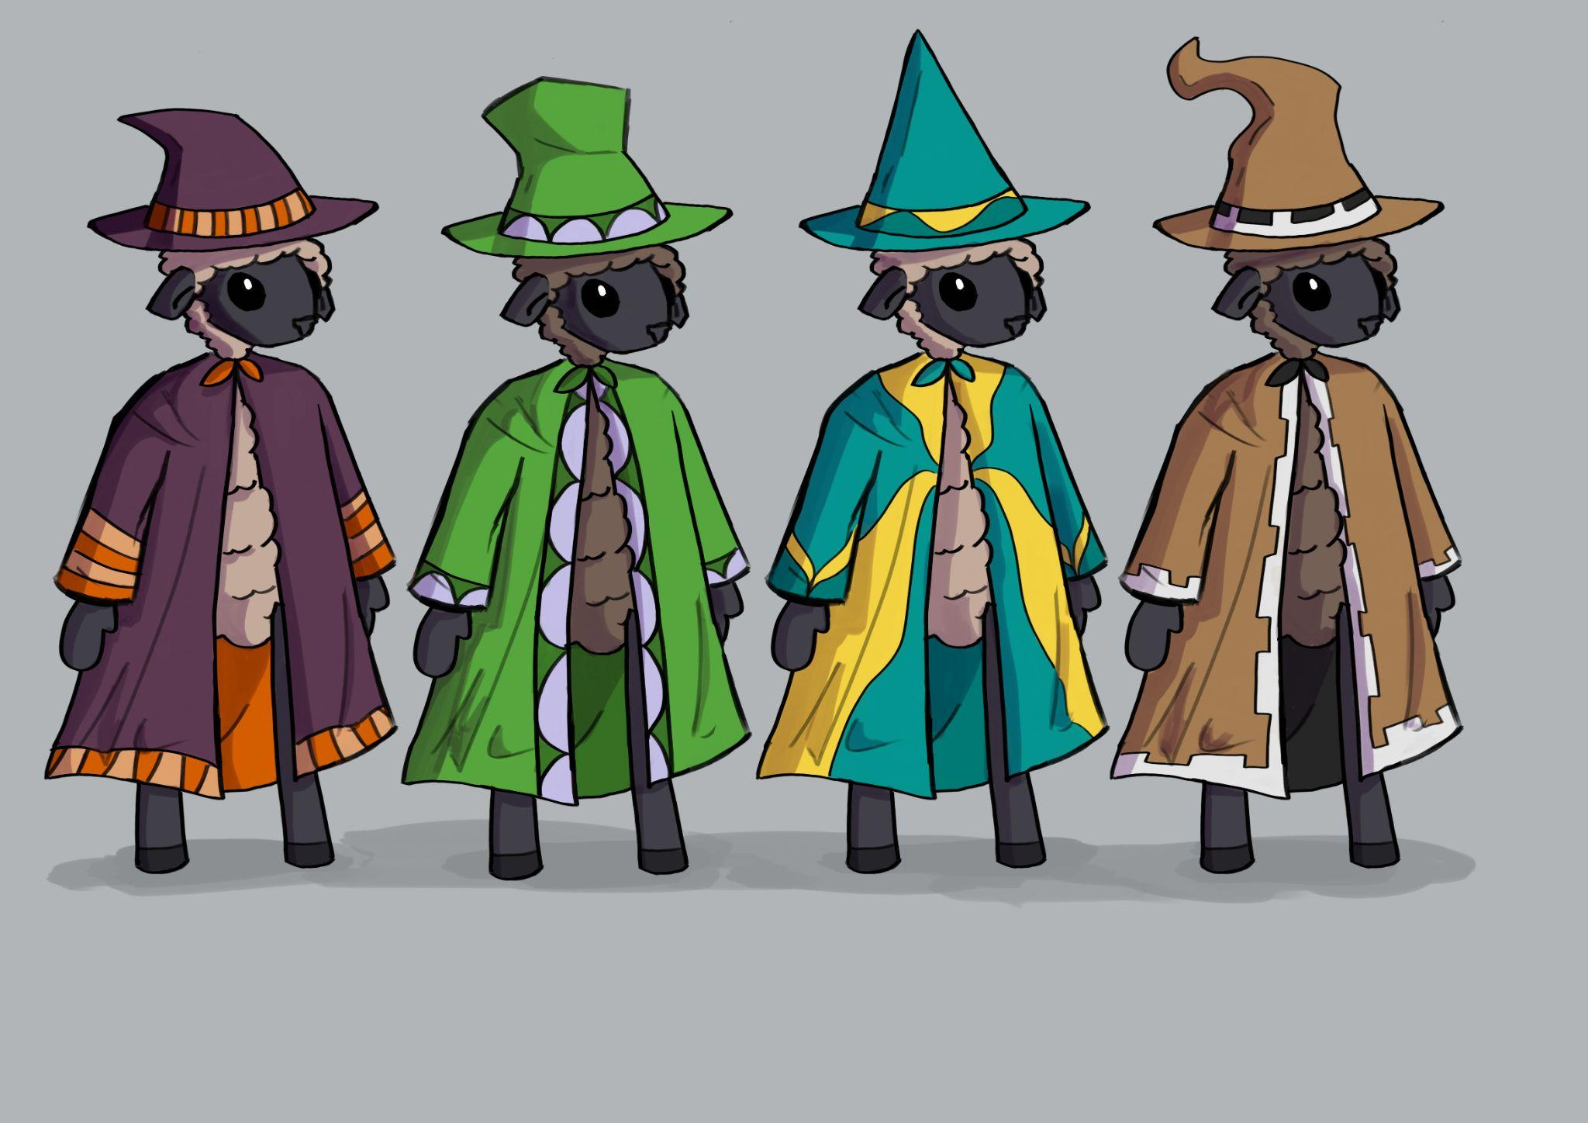
Secondary Sheep Design
These are backup designs for the wizard sheep - in case they end up being more generic and not representative of any specific element/power. Though they have different colours, someone with colorblindness might struggle telling them apart based on this. That’s why the hats are also different shapes, to identify the sheep from an isometric perspective, and the wizard-like robes have a variety of patterns, making each sheep more unique. Since the game takes in a snowy, and therefore mostly white environment, it was also a good idea to make the character colours vibrant to stand out against the less colourful background.
As a stretch, we thought it would be cool if the sheep also had magical staff since this imagery is often associated with sorcery, but the animation workload would increase so we will probably have spells coming out of the sheeps’ hands.

Slide 5
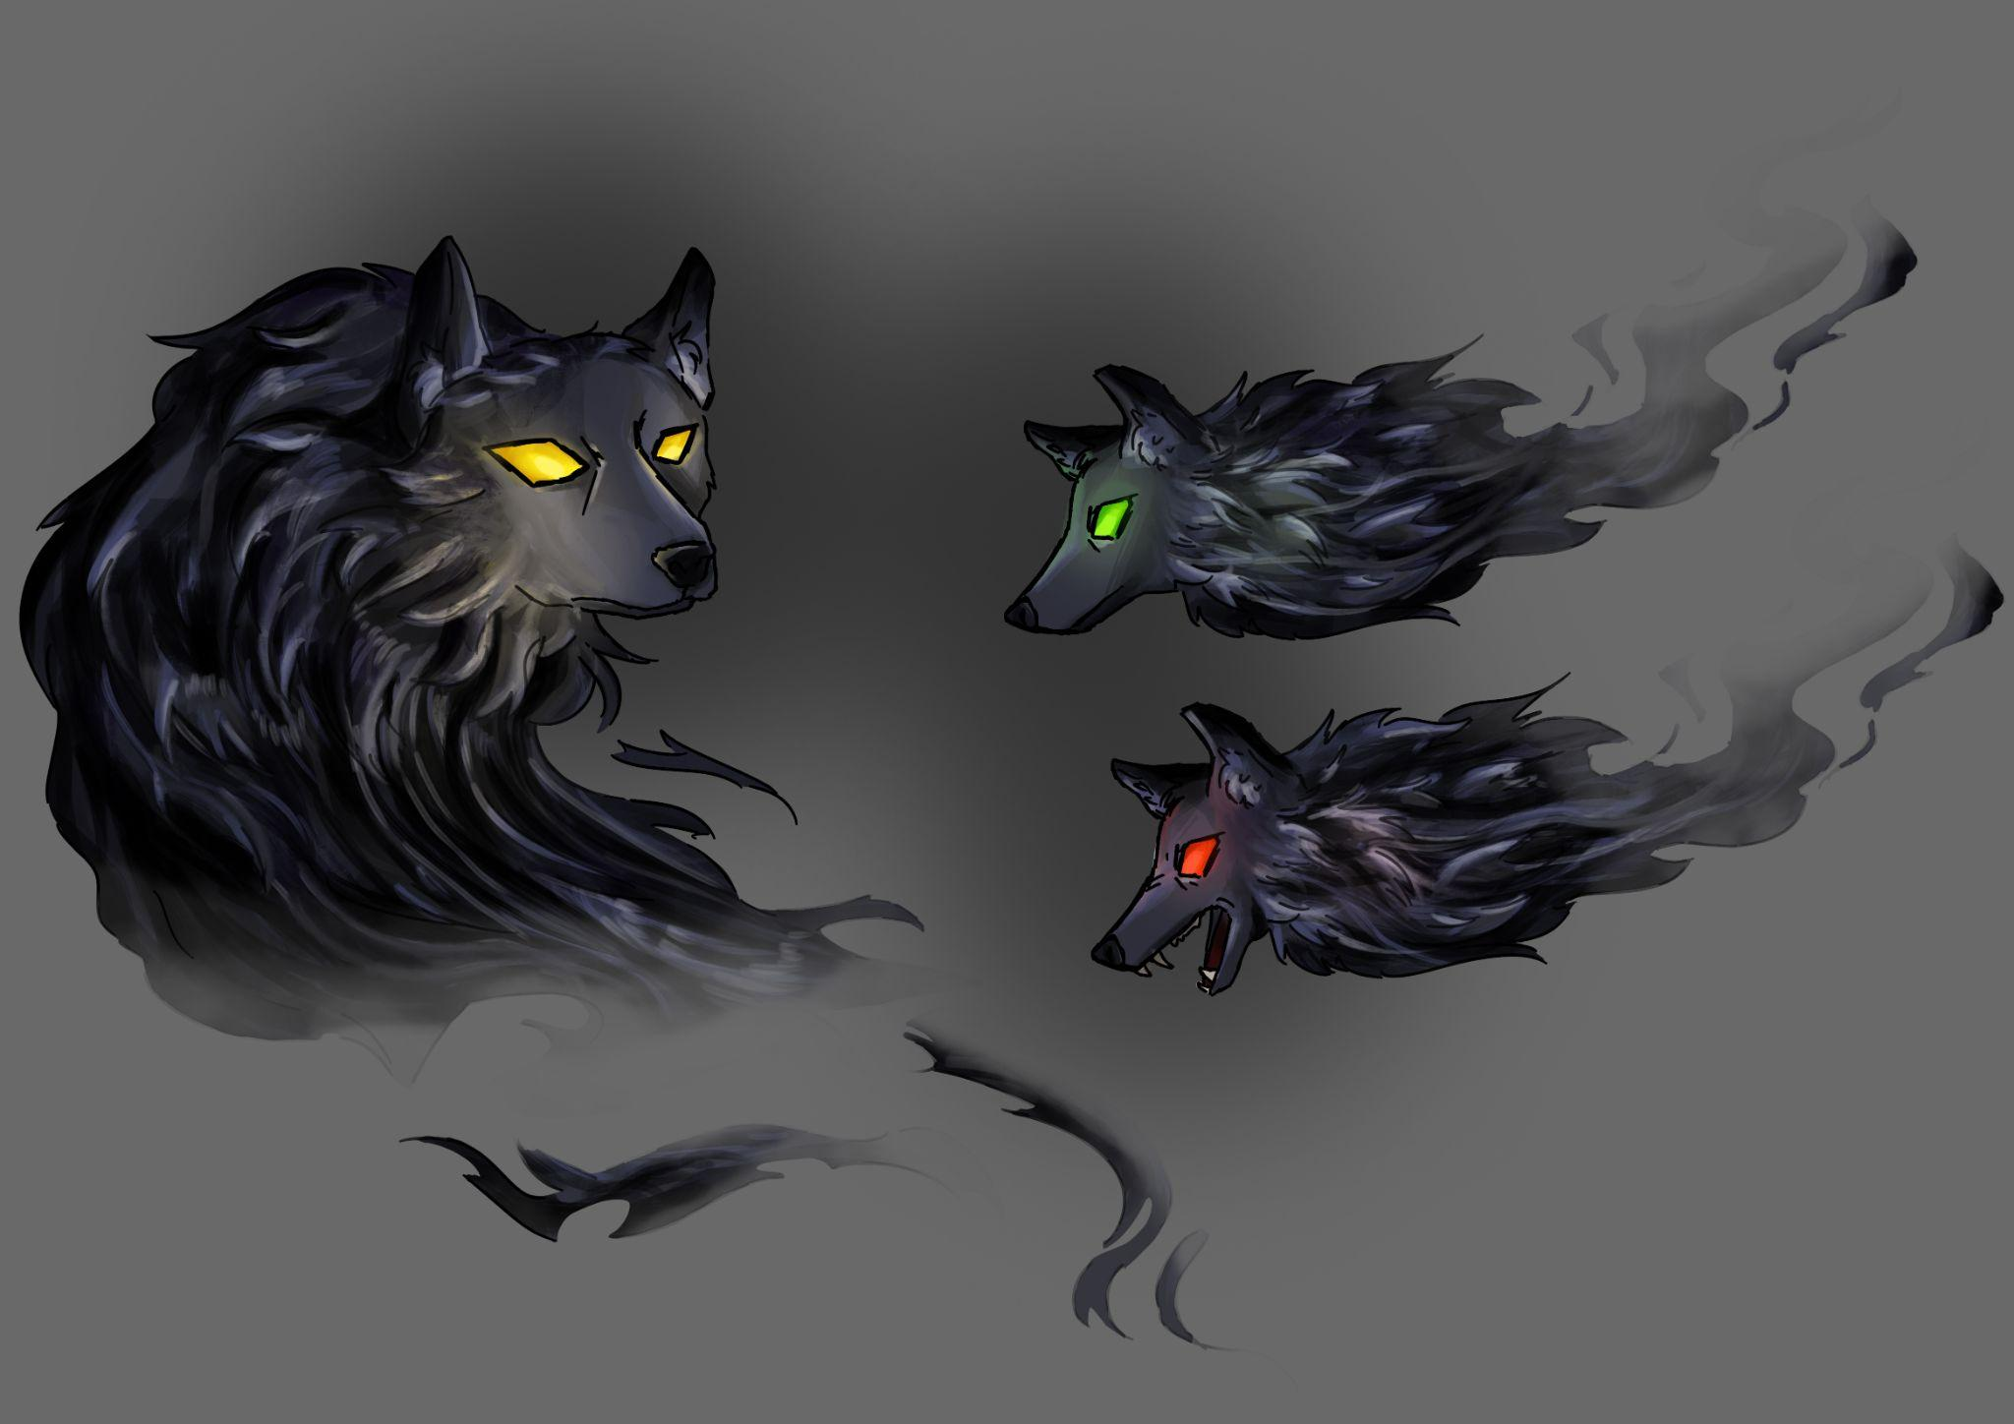
Nightmares - Wolf Ghost
This is concept art for one of the main enemies which is a wolf ghost. By giving it dark colours and sharply pointed fur as well as an angular eye shape, a sense of menace is created, contrasting the fluffy, more rounded sheep. The eye glow and floating body also make the design more supernatural and eerie since it is meant to be a nightmare. As well as that, the idea that one of the nightmares is a wolf while the main characters are sheep also creates a thematic dynamic since the imagery of sheep vs wolf is a quite traditional one - the wolf presenting danger.
The wolves will float in packs towards the base and can be repelled/destroyed by spells. They will probably be the most common/lowest ranking enemy as they won’t have any special attacks.

Slide 6
Environment

